Slide 1
Symbiosis Skill Hackathon (SSH-2026)
Team name : The BOSS
Team ID : SSHE70
Team Leader name : Trishansh Sahane
College : Devi Ahilya Vishwavidyalaya(DAVV) Indore
Project Name : Gyan-Shala
Prototype Link : https://gyanshala-delta.vercel.app/
Problem Statement : Rural students often lack clear, accessible and personalized guidance after Class 10 and 12. Career information is scattered, complex and rarely available in regional languages or low-bandwidth formats.
This leads to poor career decisions, missed scholarships and limited awareness of government opportunities.
Theme : Edtech

Slide 2
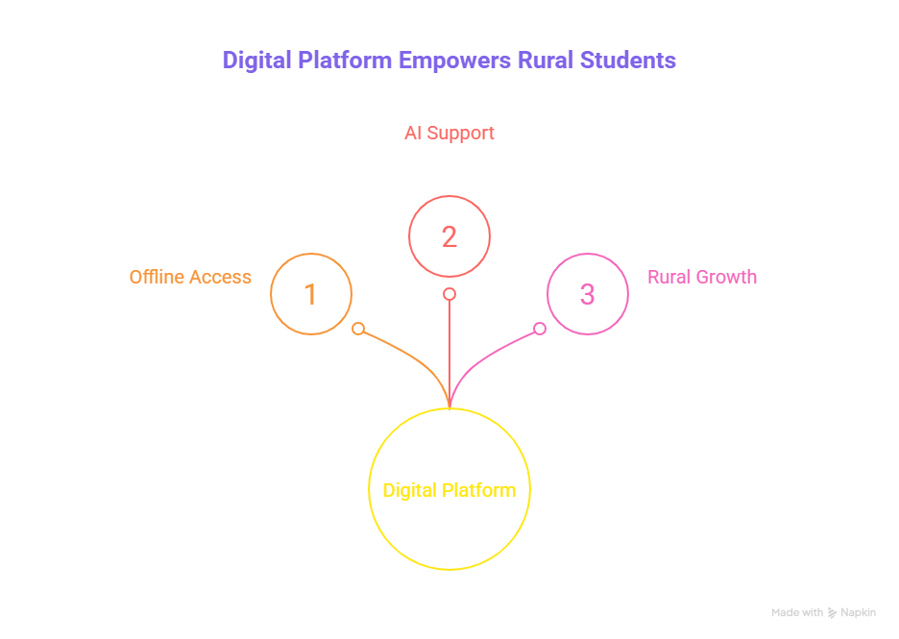
Proposed Solution:
A one-stop multilingual digital learning platform (web + mobile app) designed specifically for rural students, delivering subject-wise study content, career guidance after 10th and 12th, scholarship awareness and government exam roadmaps - all in local and regional languages.
The platform supports offline learning through downloadable content and low-data mode, ensuring uninterrupted access even in low-connectivity areas with AI-powered academic support and voice-based assistance, it enables accessible, affordable and self-driven education for rural growth.

Slide 3
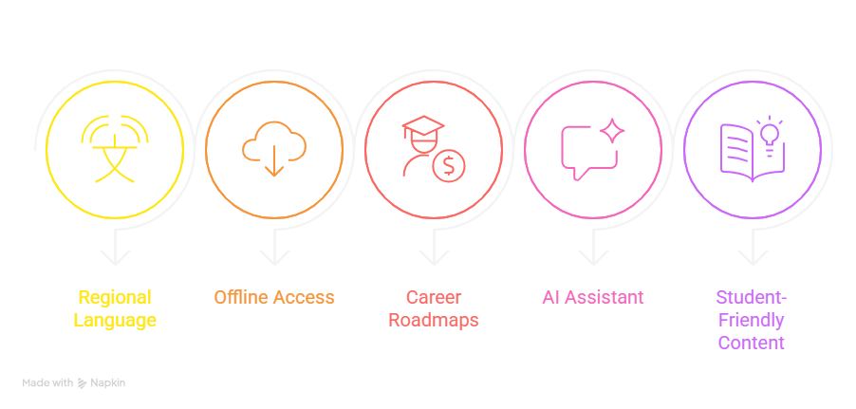
Solution Highlights (what make our solution different from others) :
Regional Language Focus : Study content and career guidance available in Hindi and regional languages for true understanding.
Offline & Low-Data Access : Downloadable resources and a lightweight platform designed for rural internet conditions.
Structured Career Roadmaps : Clear step-by-step guidance after 10th and 12th with degree options, government exams and scholarships in one place.
AI Learning Assistant : Simple doubt-solving and concept explanations in easy language.
Practical & Student-Friendly Content : Subject-wise notes and career insights explained clearly and directly.

Slide 4
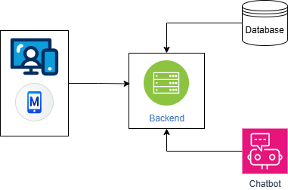
Technologies used :
Languages :
HTML CSS and JavaScript (Frontend)
Python (Chatbot)
Tools and Frameworks :
Flask and LangChain (RAG Chatbot)
MySQL (Database)
React (Website)
React Native (Mobile app)
React i18n (Translation)
Tailwind (Styling)
Architecture Diagram
Frontend

Slide 5
Target Audience : Our target audience is India’s rural school students.
Impact on ground level :
Builds Confidence: Students gain clarity about subjects, careers and future opportunities.
Right Direction at Right Time: Structured guidance after 10th/12th prevents wrong career choices.
Access for Every Student: Rural learners get equal access to quality resources and mentorship.
Career & Scholarship Awareness: Updates on exams, courses, and financial aid reduce uncertainty.

Slide 6
Implementation & Sustainability Analysis :
Technology Readiness
AI-powered learning recommendations based on student performance, smart doubt-resolution assistant, lightweight web + mobile platform, and dashboards for tracking progress, scores, and improvement trends.
Ground-Level Usability
Simple and clean interface for Class 10th and 12th students, multilingual support, mobile-friendly design, and step-by-step guided learning so even average students can use it easily without technical knowledge.
Economic Sustainability
Built using open-source tools to reduce development cost, scalable cloud deployment, and a low-maintenance model that can be adopted by schools at minimal expense.

Slide 7
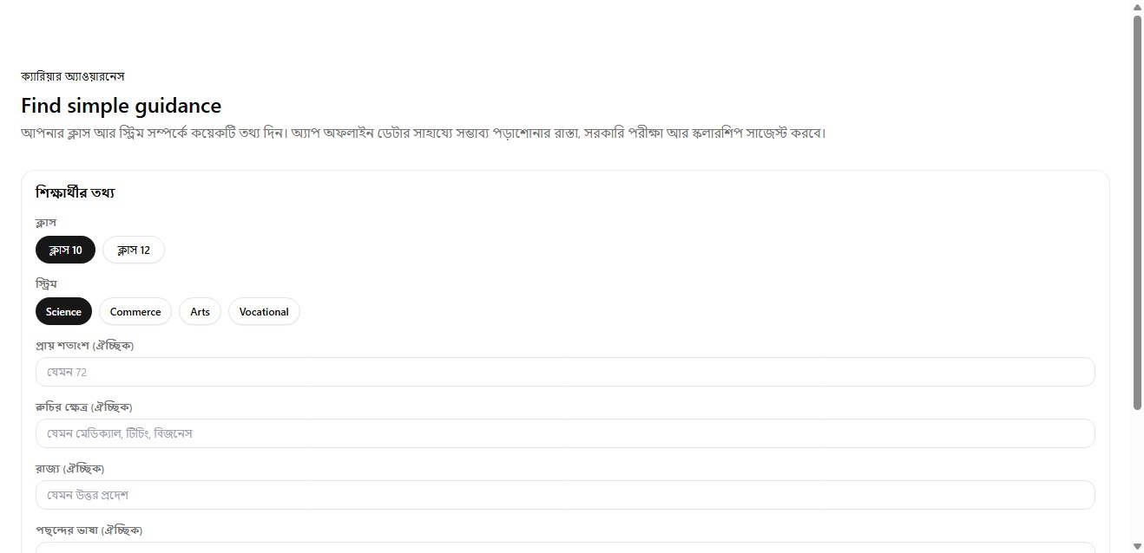
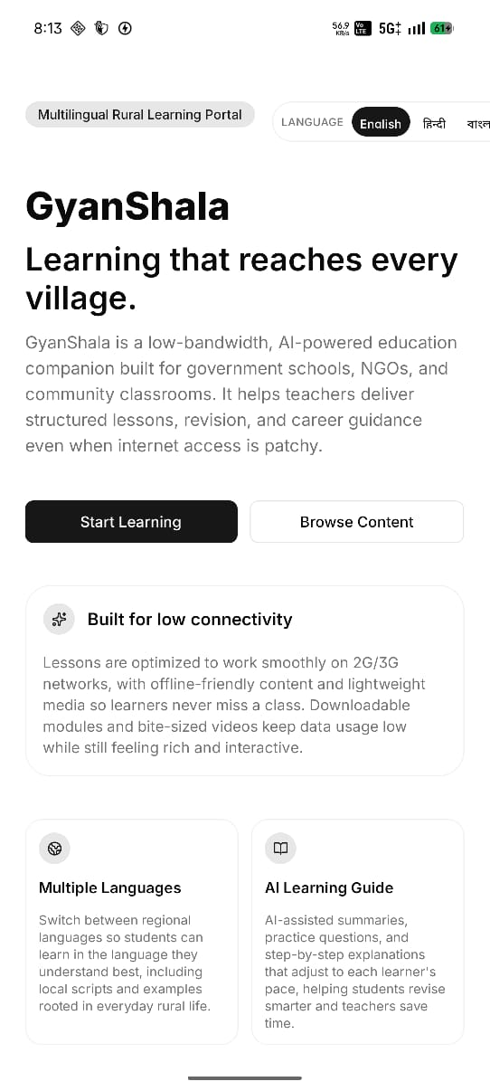
Snapshots of the project :
App View
Web View

